Slide 1
Topic 2:
The Motherboard
The Motherboard

Slide 2
The Motherboard
A motherboard is a large printed circuit board (PCB) with many integrated circuits (ICs), ports, and connectors attached to it that functions as the foundation of a PC
The motherboard (also called system board, planar board, or main board) is the nerve center of the computer system
The Motherboard

Slide 3
The Motherboard
The motherboard integrates all of the parts of the computer, and provides a way for all of them to communicate.
Everything else in the system plugs into, is controlled by, or depends on the motherboard to communicate with other devices on the system.
The Motherboard

Slide 4
The Motherboard
The system board generally houses the following components:
  Central processing unit (CPU)
  Controller circuitry
  Buses
  Random access memory (RAM)
  Expansion slots for additional boards
  Ports for external devices
The Motherboard

Slide 5
The Motherboard
  Complementary Metal Oxide Semiconductor (CMOS)
  Read Only Memory (ROM)
  BIOS chips
  Support chips providing varied functionality
The Motherboard

Slide 6
The Motherboard
All of the components that relate to the system unit connect directly to the system board
External devices would not be able to communicate with the system unit without the system board
External devices include mouse, keyboard, monitor, printer
The Motherboard

Slide 7
The Motherboard
Printed circuit boards are constructed from sheets of fiberglass. They are covered with sockets and various electronic parts, including different kinds of chips
A chip is made up of a very small circuit board etched on a square of silicon. A chip is also referred to as a semiconductor or integrated circuit (IC)
The Motherboard

Slide 8
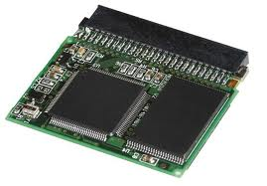
The Motherboard

Slide 9
The Motherboard
Chips vary in size, but many are about the size of a postage stamp.
The individual wires and hand-soldered connectors used in older system boards have been replaced by aluminum or copper traces printed on circuit boards.
The Motherboard

Slide 10
Motherboard Form Factors
Motherboards are usually described by their form factor. The form factor refers to the physical dimensions (size and shape) as well as certain connector, screw hole, and other positions that dictate into which type of case the board will fit
Visit www.formfactor.org for form factor information
The Motherboard

Slide 11
Motherboard Form Factor
The more commonly known PC motherboard form factors include:
Obsolete Form Factors
  Baby-AT
  Full-size AT
  LPX (semiproprietary)
  WTX (no longer in production)
  ITX (FlexATX variation, never produced)
The Motherboard

Slide 12
Motherboard Form Factor
Modern Form Factors
  BTX
  microBTX
  picoBTX
  ATX
  microATX
  flexATX
  Mini-ITX (FlexATX variation)
  NLX
The Motherboard

Slide 13
Common Industry-Standard Motherboard Form Factors
Form Factor | Use
BTX | New-generation tower and desktop systems; latest form factor; supports high-end systems
microBTX | Smaller version of BTX; used in new-generation mid-range systems; fits the microBTX or BTX chassis
The Motherboard

Slide 14
picoBTX | Smallest version of BTX; used in low-end small form factor, entertainment, or appliance systems; fits the picoBTX, microBTX, or BTX chassis
ATX | Standard tower and desktop systems; most popular between 1996 through 2004; supports high-end systems
Mini-ATX | A slightly smaller version of ATX that fits the ATX chassis; many ATX boards are sold as Mini-ATX motherboards
The Motherboard

Slide 15
microATX | Smaller version of ATX; used in mid-range systems; fits the microATX or ATX chassis
FlexATX | Smallest version of ATX; used in low-end small form factor, entertainment, or appliance systems; fits the FlexATX, microATX, or ATX chassis
The Motherboard

Slide 16
Mini-ITX | Minimum-size FlexATX version; used in set-top boxes and compact/small form factor systems; highly integrated with one PCI expansion slot; fits in the Mini-ITX, FlexATX, microATX, or ATX chassis
NLX | Corporate slim desktop or mini-tower systems; fast and easy serviceability; slots on riser card
The Motherboard

Slide 17
The ATX Form Factor
The ATX form factor was the first of a dramatic evolution in motherboard form factors
ATX is a combination of the best features of the Baby-AT and LPX motherboard designs, with many new enhancements and features added.
The Motherboard

Slide 18
The ATX Form Factor
The ATX form factor is essentially a Baby-AT motherboard turned sideways in the chassis, along with a modified power supply location and connector
The ATX form factor is physically incompatible with either the previous Baby-AT or LPX design from which it evolved
The Motherboard

Slide 19
The ATX Form Factor
Most new systems come with the ATX motherboard form factor, which differs from the AT motherboard form factor in the following ways:
  The expansion slots are parallel to the short side of the board, which allows more space for other components.
The Motherboard

Slide 20
The ATX Form Factor
  The CPU and RAM are located next to the power supply. These components consume a lot of power, so they need more cooling by the fan of the power supply.
  An integrated I/O port and PS/2 mouse connectors are included on the motherboard.
  +3.3 volt operation from an ATX power supply are supported.
The Motherboard

Slide 21
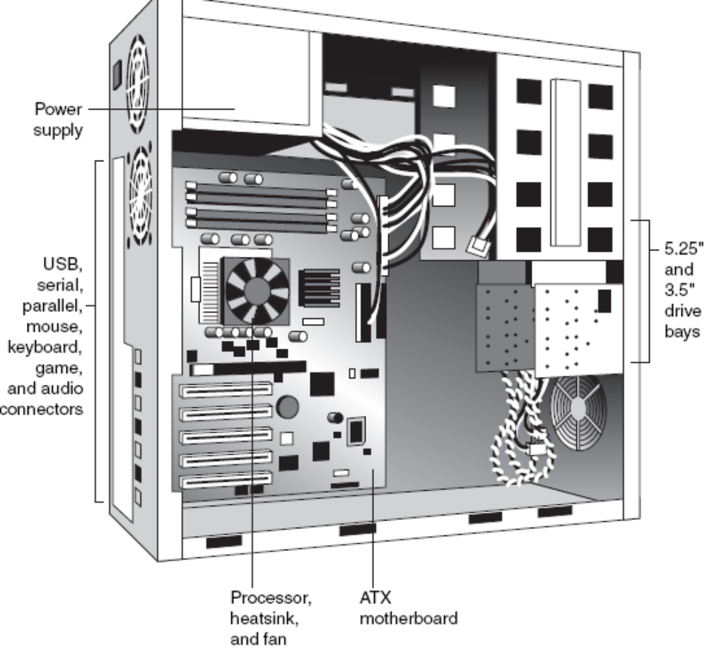
The Motherboard

Slide 22
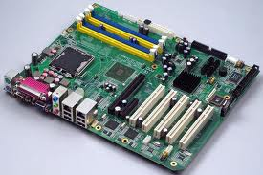
The Motherboard

Slide 23
The ATX Form Factor
Some improvements the ATX main board form factor has over Baby-AT Boards include:
  Built-in double high external I/O connector panel allowing for external connectors to be located directly on the board instead of cables running from internal connectors to the back of the case as in Baby-AT design
The Motherboard

Slide 24
The ATX Form Factor
  Single keyed internal power supply connector that is easy to plug in and that cannot be installed incorrectly.
  The ATX power connector also features pins for supplying +3.3 volts to the motherboard, meaning that ATX motherboards don’t need built-in voltage regulators that are susceptible to failure.
The Motherboard

Slide 25
The ATX Form Factor
  Relocation of CPU and memory such that they do not interfere with bus expansion cards, and can be accessed for upgrade without removing any of the installed bus adapters. The CPU and memory are also located close to the PSU for ease of powering and cooling by the PSU fan.
  Relocated internal I/O connectors for the floppy and hard disk drives closer to the drive bays allowing for shorter cables to the drives.
The Motherboard

Slide 26
The ATX Form Factor
  Improved cooling of the CPU and memory directly by the PSU fan, eliminating the need for separate case or CPU cooling fans.
  Lower cost to manufacture. The ATX specification eliminates the need for many cables to external port connectors found on Baby-AT motherboards, additional CPU or chassis cooling fans, or onboard +3.3V voltage regulators. Instead, ATX allows for shorter internal drive cables and no cables for standard external serial or parallel ports.
The Motherboard

Slide 27
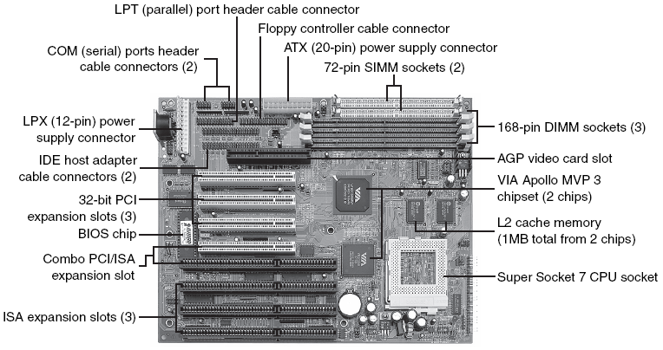
Baby-AT motherboard
The Motherboard

Slide 28
Variations of the ATX Form Factor
Full-size ATX - 12'' wide × 9.6'' deep (305mm×244mm)
Mini-ATX - 11.2''×8.2'' (284mm×208mm)
microATX - 9.6''×9.6'' (244mm×244mm)
FlexATX - 9''×7.5'' (229mm×191mm)
The Motherboard

Slide 29
ATX Riser Card
In 1999, Intel introduced a riser card design modification for ATX motherboards.
The design includes the addition of a 22-pin (2×11) connector to one of the PCI slots on the motherboard, along with a two- or three-slot riser card that plugs in.
The riser enables two or three PCI cards to be installed, but it does not support AGP.
The Motherboard
Notes:
The Accelerated Graphics Port (often shortened to AGP) is a high-speed point-to-point channel for attaching a video card to a computer's motherboard, primarily to assist in the acceleration of 3D computer graphics

Slide 30
The BTX Form Factor
Balanced Technology Extended (BTX) is a motherboard form factor specification Intel originally released in 2003
BTX is designed to eventually replace the venerable ATX form factor while addressing ever-increasing component power and cooling requirements, as well as enabling improved circuit routing and more flexible chassis designs
The Motherboard
Notes:
.

Slide 31
The BTX Form Factor
BTX represents a completely new form factor that is not backward-compatible with ATX or other designs
A full-size BTX board is 17% larger than ATX, allowing room for more integrated components onboard
The I/O connectors, slots, and mounting holes are in different locations than with ATX, requiring new chassis designs
The Motherboard

Slide 32
The BTX Form Factor
However, the power supply interface connectors are the same as in the latest ATX12V specifications, and newer ATX, TFX, SFX, CFX, and LFX power supplies can be used
CFX and LFX power supply form factors were specifically created to support compact and low-profile BTX systems.
The Motherboard

Slide 33
Primary Advantages to BTX
  Optimized inline component layout and routing. Signals are aligned front to back, allowing connections between components and I/O connectors to run unobstructed.
  Optimized airflow path. Allows for a condensed system design and an optimized, unobstructed airflow path for efficient system cooling with fewer fans and lower acoustics.
The Motherboard

Slide 34
Primary Advantages to BTX
  Support and retention module (SRM). Offers mechanical support for heavy heatsinks. It also helps to prevent board flexing or damaging board components and traces during shipping and handling.
  Scalable board dimensions. Flexible board sizes enable developers to use the same components for a variety of system sizes and configurations.
The Motherboard

Slide 35
Primary Advantages to BTX
  Low-profile options. Component keep-out specifications enable lower profiles, making it easier to design slim-line or small form factor systems.
  Flexible, compatible power supply designs. Connectors are shared with recent ATX designs; smaller, more efficient power supply form factors can be used for small form factor systems.
The Motherboard

Slide 36
Variations of BTX Form Factor
BTX includes three definitions of motherboard size:
  BTX 12.8'' (325mm) x 10.5'' (267mm)
  microBTX 10.4'' (264mm) x 10.5'' (267mm)
  picoATX 8.0'' (203mm) x 10.5'' (267mm)
The Motherboard

Slide 37
Single-processor and Dual-processor Motherboards
Motherboards may be described as dual processor or single processor.
Single processor boards can accommodate only one processor chip. Due to ever increasing demand for PC processing power single processors are not always able to meet the demand, especially in corporate networking environments.
The Motherboard

Slide 38
Single-processor and Dual-processor Motherboards
Dual processor boards are usually installed for advanced network operating systems.
Boards are also sometimes described by the type of microprocessor interface, or the socket they present hence they are described as Socket 1, socket 7, Slot 370, etc. Slot 1 is first generation ATX. Single Socket 370 is second generation ATX.
The Motherboard

Slide 39
Components of the Motherboard
The components found on a motherboard can vary depending on the age of the board and the level of integration.
A modern board has several components built in, including various sockets, slots, connectors, chips, and so on
The Motherboard

Slide 40
Components of the Motherboard
Most modern boards have at least the following major components on them:
  Processor socket/slot
  Chipset (North/South Bridge or memory and I/O controller hubs)
  Super I/O chip
  ROM BIOS (Flash ROM/firmware hub)
The Motherboard

Slide 41
Components of the Motherboard
  SIMM/DIMM/RIMM (RAM) sockets
  ISA/PCI/AGP bus slots
  CPU voltage regulator
  Battery
Some boards also include integrated video, audio, networking, SCSI, Audio Modem Riser (AMR), Communications and Networking Riser (CNR) connectors, etc.
The Motherboard

Slide 42
Component | Description
Chipset | A set of microcircuits that define how much RAM a board can use, type of RAM chip, cache size and speed, processor types and speeds, and the types of expansion slots the board can accommodate
CPU Interface | The socket or slot that the CPU connects to on the motherboard
Expansion slots | Receptacles on the board that accept printed circuit boards. All computers have expansion slots that allow additional devices to be added
The Motherboard

Slide 43
Dip Switches and Jumpers | These devices are used to change various aspects of how the board is configured
I/O Support | These are connectors for input and output devices controlled by the main board
Internal Buses | Channel for data to move between the devices attached to the system, to the CPU, and its components
Power Supply Socket | The connection for the power supply
The Motherboard

Slide 44
BIOS Chip | Provides the computer with the very basic instructions to start the computer and check hardware for errors
RAM Sockets | Connectors for inserting memory chips for the computer
CPU clock | Establishes the maximum speed at which the processor can execute commands
Battery | Keeps system time and provides a way for the BIOS to remember certain settings
The Motherboard

Slide 45
The Chipset
We can’t talk about modern boards without discussing chipsets
The chipset is the motherboard; therefore, any two boards with the same chipsets are functionally identical.
The chipset contains the processor bus interface (called front-side bus, or FSB), memory controllers, bus controllers, I/O controllers, and more.
The Motherboard

Slide 46
The Chipset
All the circuits of the board are contained within the chipset. If the processor is like the engine in a car, the chipset represents the chassis
It is the framework in which the engine rests and is its connection to the outside world. The chipset is the frame, suspension, steering, wheels and tires, transmission, drive shaft, differential, and brakes.
The Motherboard

Slide 47
The Chipset
The chipset represents the connection between the processor and everything else. The processor can’t talk to the memory, adapter cards, devices, etc without going through the chipset. The chipset is the main hub and central nervous system of the PC.
If you think of the processor as the brain, the chipset is the spine and central nervous system
The Motherboard

Slide 48
The Chipset
Because the chipset controls the interface or connections between the processor and everything else, the chipset dictates
  which type of processor the board can use
  how fast it will run
  how fast the buses will run
The Motherboard

Slide 49
The Chipset
  the type, speed, and amount of RAM to use
  type of RAM chip
  cache size and speed
  types of expansion slots the board can accommodate
  and more
The Motherboard

Slide 50
The Chipset
In fact, the chipset might be the single most important component in a system, perhaps even more important than the processor
The chipset determines the compatibility of the board with several other vital system components
The Motherboard

Slide 51
The Chipset
It determines the performance and limitations of the board.
The chipset consists of a group of microcircuits contained on several integrated chips or combined into one or two very large scale integration (VLSI) integrated chips. VLSIs are chips that have over 20,000 circuits.
The Motherboard

Slide 52
The Chipset
The chipset therefore, is a group of computer chips or ICs that work together to manage and control the computer system.
This set includes the CPU and other chips that control the flow of data through out the system.
The Motherboard

Slide 53
Traditional North/South Bridge Architecture
Most earlier chipsets are broken into a multi-tiered architecture incorporating what are referred to as North and South Bridge components, as well as a Super I/O chip:
  The North Bridge. So named because it is the connection between the high-speed processor bus and the slower AGP and PCI buses.
  The South Bridge. So named because it is the bridge between the PCI bus and the even slower ISA bus.
The Motherboard

Slide 54
Traditional North/South Bridge Architecture
  The Super I/O chip. A separate chip attached to the ISA bus that is not really considered part of the chipset. It contains commonly used peripheral items all combined into a single chip.
Note that most recent South Bridge chips now include Super I/O functions (called Super-South Bridge chips), so that recent boards no longer include a separate Super I/O chip
The Motherboard

Slide 55
Traditional North/South Bridge Architecture
The figure below shows a typical AMD Socket A motherboard using North-South Bridge architecture with the locations of all chips and components.
The Motherboard

Slide 56
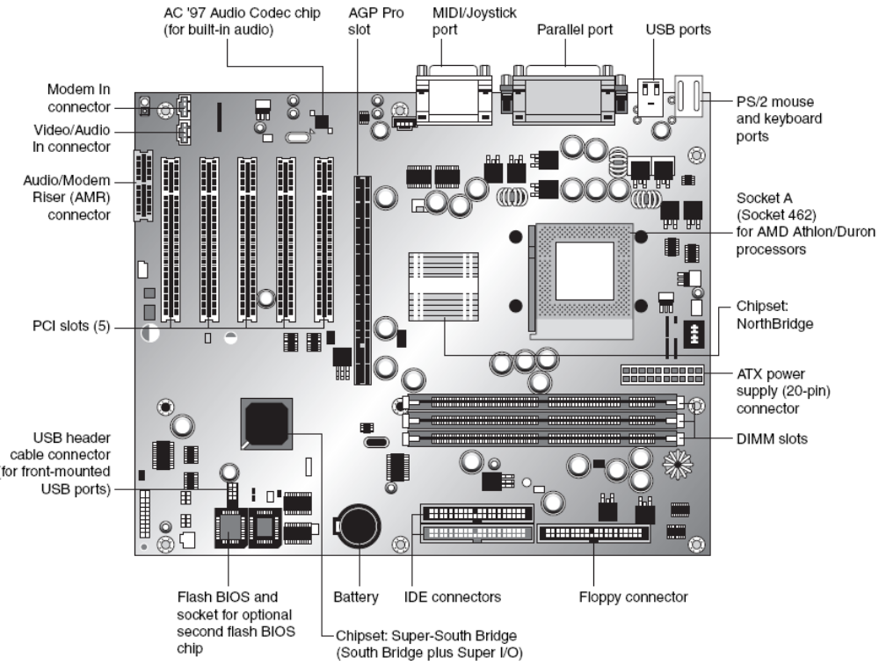
The Motherboard

Slide 57
The North Bridge
Also called the PAC (PCI/AGP Controller), it is essentially the main component of the board and is the only circuit besides the processor that normally runs at full board (processor bus) speed
Most modern chipsets use a single-chip North Bridge; (older ones may consist of up to three individual chips to make up the complete North Bridge circuit)
The Motherboard

Slide 58
The South Bridge
The South Bridge is the lower-speed component in the chipset and has always been a single individual chip
The South Bridge is a somewhat interchangeable component in that different chipsets (North Bridge chips) often are designed to use the same South Bridge component.
The Motherboard

Slide 59
The South Bridge
The South Bridge connects to the 33MHz PCI bus and contains the interface or bridge to the 8MHz ISA bus (if present).
It also typically contains dual ATA/IDE hard disk controller interfaces, one or more USB interfaces, and in later designs even the CMOS RAM and real-time clock functions.
The Motherboard

Slide 60
The South Bridge
In older designs, the South Bridge contained all the components that make up the ISA bus, including the interrupt and DMA controllers.
The third board component, the Super I/O chip, is connected to the 8MHz ISA bus or the low pin count (LPC) bus and contains all the standard peripherals that are built in to a board
The Motherboard

Slide 61
The South Bridge
For example, most Super I/O chips contain the serial ports, parallel port, floppy controller, and keyboard/mouse interface. Optionally, they might contain the CMOS RAM/Clock, IDE controllers, and game port interface as well
Systems that integrate IEEE 1394 and SCSI ports use separate chips for these port types
The Motherboard

Slide 62
Super-South Bridge
Most recent motherboards that use North/South Bridge chipset designs incorporate a Super-South Bridge, which incorporates the South Bridge and Super I/O functions into a single chip.
The Motherboard

Slide 63
Hub Architecture
The newer 800 series chips from Intel use hub architectures in which the former North Bridge chip is now called a Memory Controller Hub (MCH) and the former South Bridge is called an I/O Controller Hub (ICH)
Rather than connect them through the PCI bus as in a standard North/South Bridge design, they are connected via a dedicated hub interface that is twice as fast as PCI
The Motherboard

Slide 64
Hub Architecture
The hub design offers advantages over the North/South Bridge design:
  It’s faster. The hub interface used by the 8xx series has twice the throughput of PCI (33MH)
  Reduced PCI loading. The hub interface is independent of PCI and doesn’t share PCI bus bandwidth for chipset or Super I/O traffic
  Reduced board wiring and therefore, more economical
The Motherboard

Slide 65
Hub Architecture
The hub interface design allows for greater throughput for PCI devices because there is no South Bridge Chip (also carrying traffic from the Super I/O chip) hogging the PCI bus
Due to bypassing the PCI, the hub architecture also enables greater throughput for devices directly connected to the I/O Controller Hub, such as the higher-speed ATA-100, Serial ATA, and USB 2.0 interfaces
The Motherboard

Slide 66
Hub Architecture
The MCH interfaces between the high-speed processor bus (800/533/400/133/100/66MHz) and the hub interface (66MHz) and AGP bus (533/266/133/66MHz), whereas the ICH interfaces between the hub interface (66MHz) and the ATA (IDE) ports (66/100MHz), the SATA ports on the ICH5 (150MHz), and the PCI bus (33MHz)
The Motherboard

Slide 67
Hub Architecture
The figure below shows a typical Intel board that uses bus architecture, the Intel D875PVZ, which supports the Intel Pentium 4 processor
Unlike some of Intel’s less-expensive hub-based boards, the Intel D875PVZ’s 875 chipset doesn’t incorporate video
The Motherboard

Slide 68
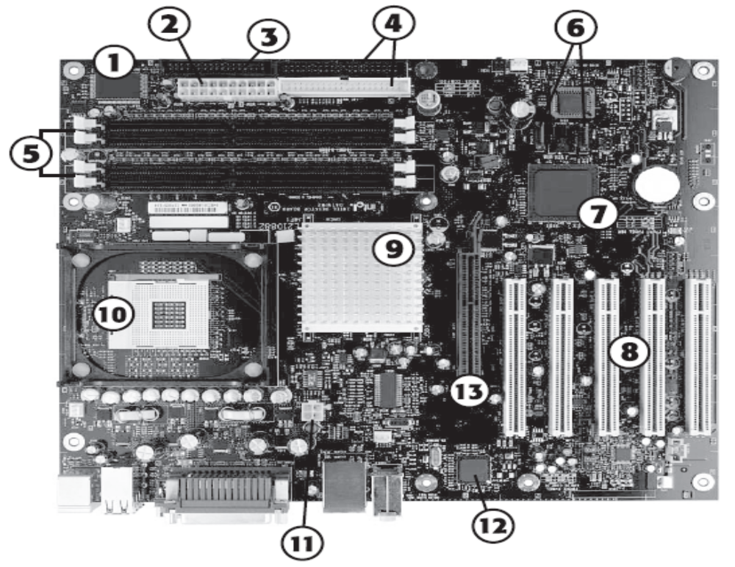
The Motherboard

Slide 69
Key:
I/O Controller chip
ATX power supply connector
Floppy drive controller
Primary/Secondary ATA/IDE host adapters
DDR DIMM RAM banks
SATA/SATA RAID host adapters (2)
Intel ICH5-R (82801ER) I/O Controller Hub (includes SATA RAID)
The Motherboard

Slide 70
Key:
PCI expansion slots (5)
Chipset North Bridge
Socket 478 for Pentium 4/Celeron 4 processor
ATX12V power supply connector
Intel 82547 Gigabit LAN PLC chip
AGP 8x slot
The Motherboard

Slide 71
High-Speed North-South Bridge Connections
As we already know, Intel developed a replacement for the traditional North-South Bridge architecture, the hub architecture.
This 266MBps interface provides faster connection between the MCH/graphics MCH and the I/O controller hub in Intel 8xx-series chipsets for the Pentium III and Pentium 4 processor families
The Motherboard

Slide 72
High-Speed North-South Bridge Connections
The 9xx-series chipsets for the Pentium 4 processor use a 2G hub architecture that boosts the connection speed to 1GBps.
Other companies have also replaced the slow PCI bus connection between North/South Bridge – type chips with high-speed chipset architectures that bypasses the PCI bus:
The Motherboard

Slide 73
High-Speed North-South Bridge Connections
  VIA. VIA created the V-Link architecture to connect its North/South Bridge chips at speeds matching or exceeding Intel hub architecture
  SiS. SiS’s MuTIOL architecture provides performance comparable to VIA’s 4x V-Link
  ATI. ATI uses a high-speed interconnect called A-Link in its 9100-series IGP integrated chipsets
  NVIDIA. NVIDIA’s nForce, nForce2, and nForce3 chipsets use the HyperTransport bus originally developed by AMD
The Motherboard

Slide 74
Manufacturers of Chipsets
Chipset manufacturers include:
  Advanced Micro Devices, (AMD) Inc.
  VIA Technologies
  Intel Corp
  Ali Corporation (ALi), former Acer Laboratories Inc.
  Silicon Integrated Systems (SiS) Corp
  Opti Inc.
The Motherboard

Slide 75
Processor Sockets/Slots
The CPU is installed in either a socket or a slot, depending on type of chip
Originally, all processors were mounted in sockets (or soldered to the board)
Starting with PII and original Athlon processors, Intel and AMD shifted to slot-based processors because the processors now incorporated built-in L2 cache, purchased as separate chips from 3rd party SRAM memory chip manufacturers
The Motherboard

Slide 76
Processor Sockets/Slots
The processor then consisted of several chips, all mounted on a daughterboard that was then plugged into a slot in the board
However, there were additional expenses in the extra cache chips, daughterboard itself, the slot, optional casings/packaging, support mechanisms and physical stands and latches for the processor and heatsink
The Motherboard

Slide 77
Processor Sockets/Slots
Slot-based processors were more expensive to produce than the socket versions.
With the integration of L2 cache directly into the processor die in Celeron, PIII, K6-3, Duron, and Thunderbird, the processor was back to being a single chip
All modern processors now have integrated L2 cache (or L3 cache) that runs at full CPU speed and use the socket
The Motherboard

Slide 78
Processor Socket Types
Microprocessor work uses specific terminology, including Socket 7, socket 4, Socket 423, or Slot 1, Slot 2, Slot A.
These are descriptive terms for the way the CPU plugs into the board. The processor plugs in to make contact with the built-in circuitry or data bus of the board
The Motherboard

Slide 79
Processor Socket Types
Socket 7, (obsolete), is the best known of the major connection variations that have been designed
Socket types that are followed by a larger number are more current. E.g., Socket 370 is more current than Socket 7
Socket type processors use the Zero Insertion Force (ZIF) socket
The Motherboard

Slide 80
Processor Socket Types
A ZIF socket allows the easy insertion of the microprocessor. A typical ZIF socket contains a lever that opens and closes to secure the microprocessor in place
Also, the various sockets have a differing number of pins and pin layout arrangements e.g., Socket 7 has 321 pins
The number of pins generally increases with the socket numbering
The Motherboard

Slide 81
Motherboard Connectors
There are a variety of connectors on a modern board (see figure below)
These connectors include power supply connectors, serial, parallel ports, keyboard, and mouse connectors
Reading assignment: Motherboard interface and I/O connector configurations and pinouts
The Motherboard

Slide 82
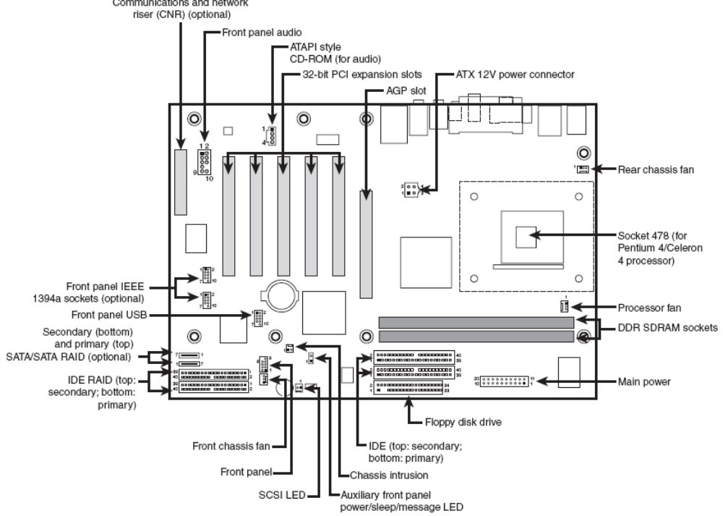
The Motherboard

Slide 83
SUMMARY
FORM FACTORS
RISER CARDS
CHIPSETS
TROUBLESHOOTING
The Motherboard

